Slide 1
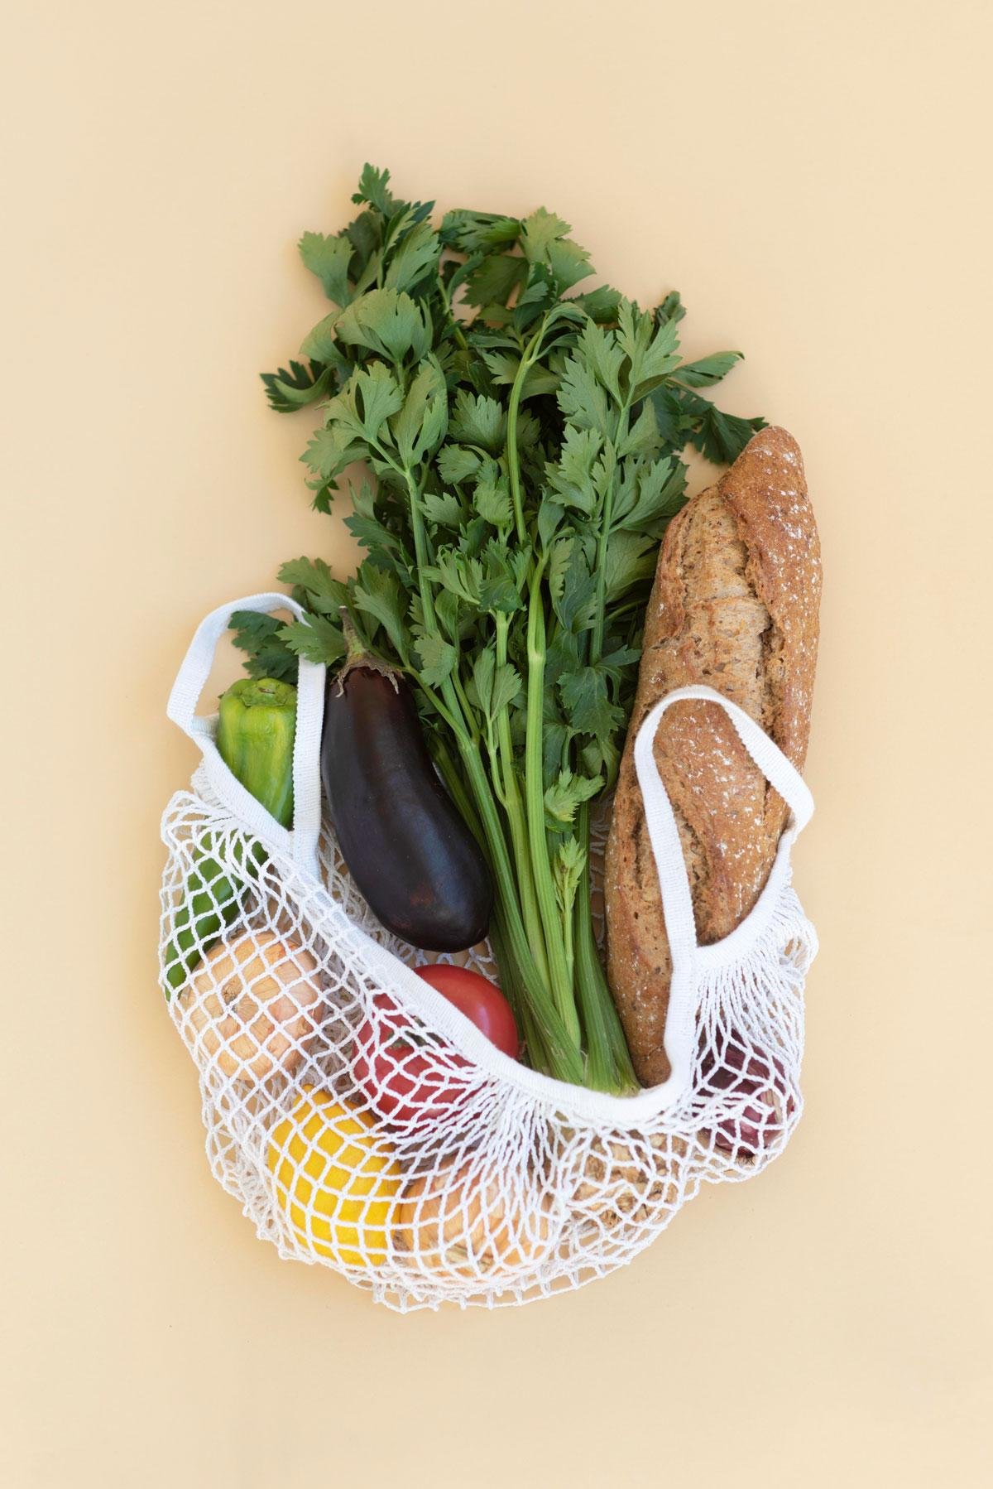
AI For Social Good: Using AI to Reduce Food Waste
By: Yusef Essawi, Drew Hollar, Ilyas Jaghoori, Hayden Johnson, Maseel Shah

Slide 2
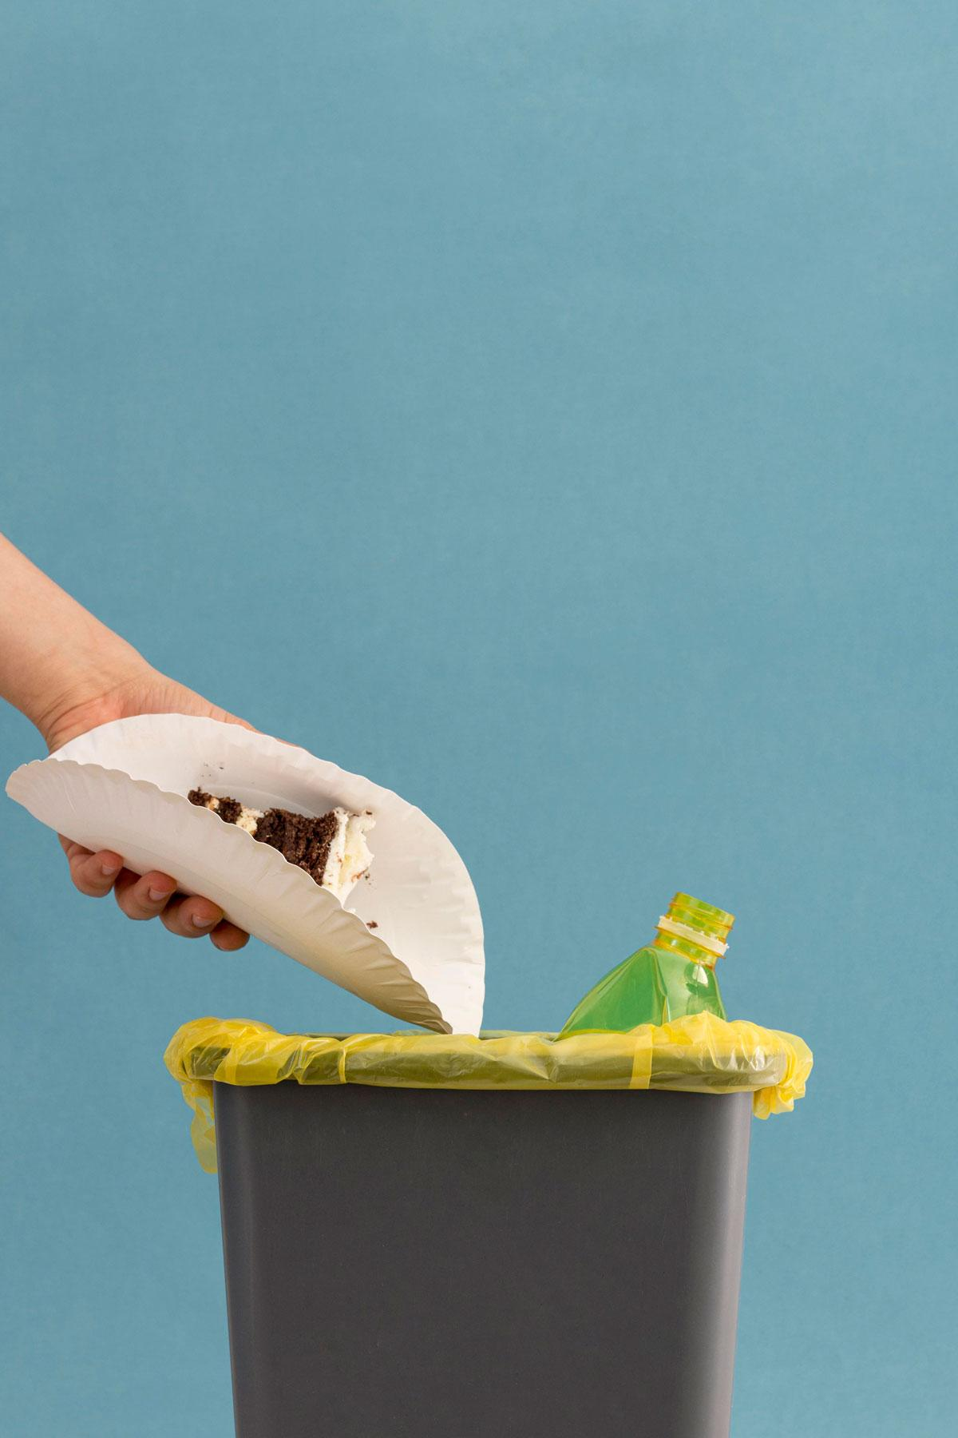
MOTIVATION & PROBLEM DEFINITION
Background & Problem
Solution
Approximately 66 million tons of food is wasted annually in the U.S.
Problem: 44.2 million households face food insecurity
Includes 12.8% of households in the US in 2022
Use AI models to predict if fruits are rotten based on image classification
Goal: Maximize Food Use
Impact: Food can be salvaged and repurposed rather than filling up landfills

Slide 3
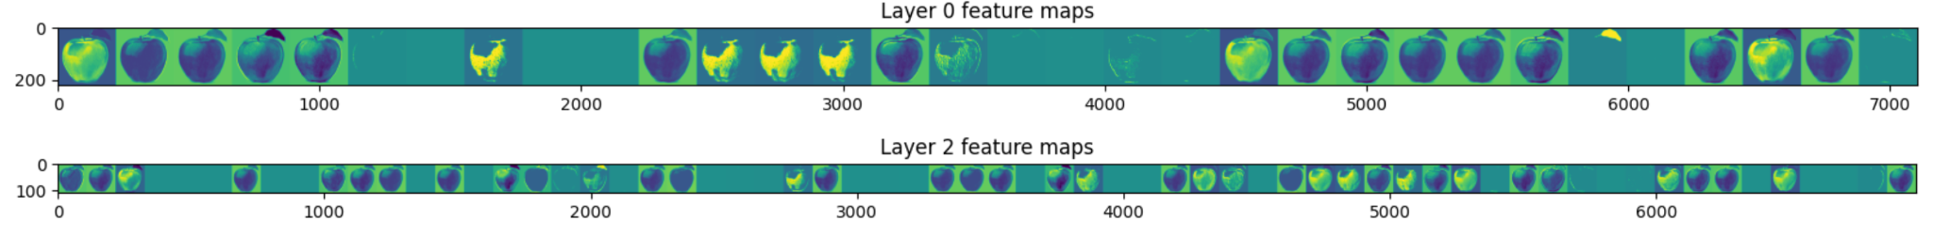
METHODS
Data Set
MobileNet
Kaggle: Fresh and Rotten Classification
Trained to identify between fresh and rotten foods
14 classes (ex. fresh tomatoes, rotten apples, etc.)
Global Average Pooling layer and a custom Dense output layer
Keeps its pre-trained layers frozen
ResNet
Convolutional Neural Network
Constructed from scratch
Convolutional, Pooling, and Dense layers
ReLU Activation
Softmax output
Uses ResNet50 Deep learning tools
Global Average Pooling and Dense output layer

Slide 4
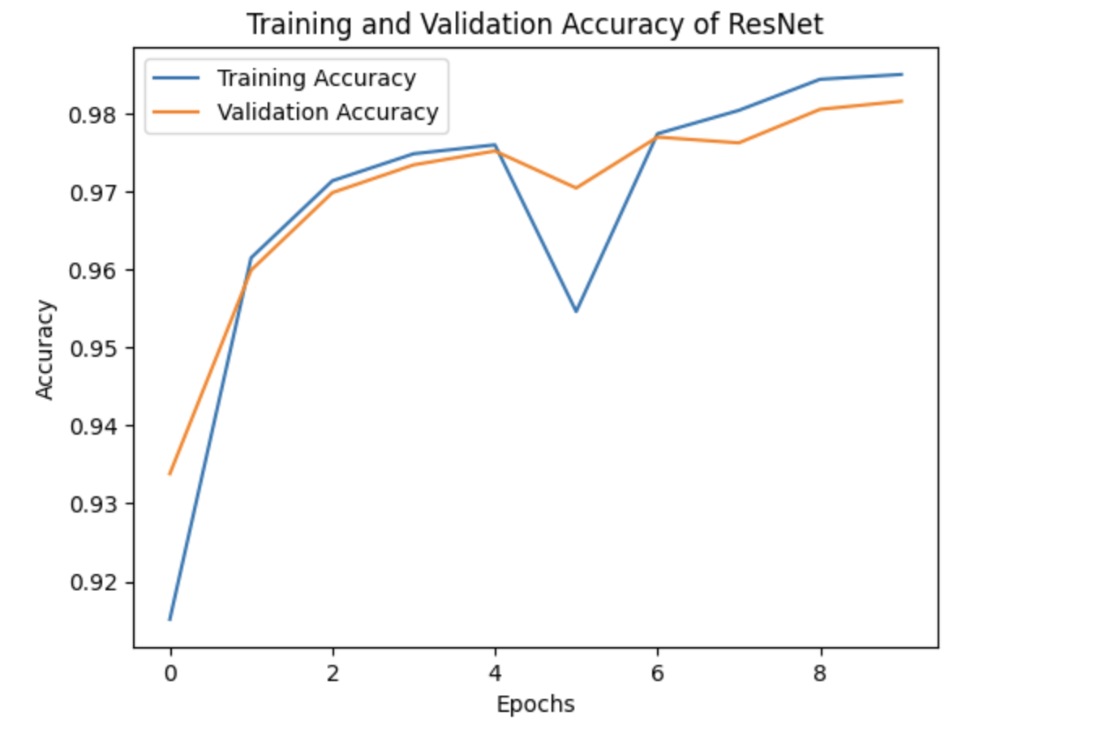
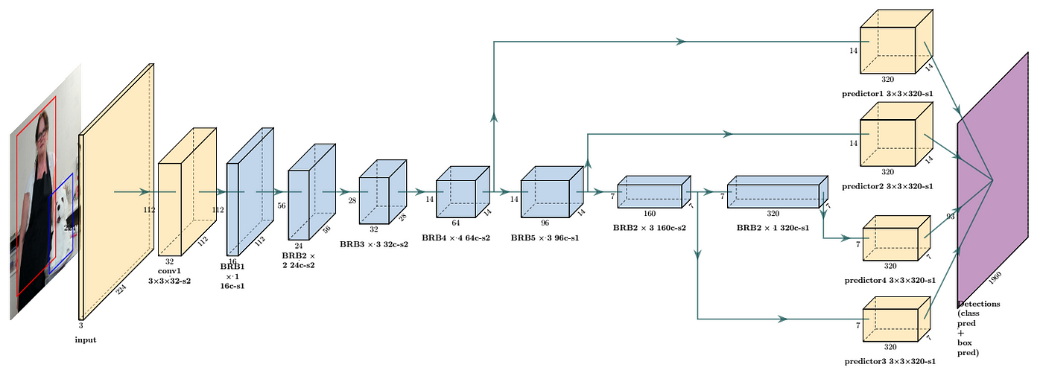
EXPERIMENTS
Experiment Structure:
Process each image as needed
Trained each of the 3 model architectures under # epochs
Optimize our models using Adam optimizer and SGD
Analyze the results of each model
Metrics:
Accuracy, precision, and recall
Confusion matrices to display all the models’ performance across each class
MobileNet Architecture

Slide 5
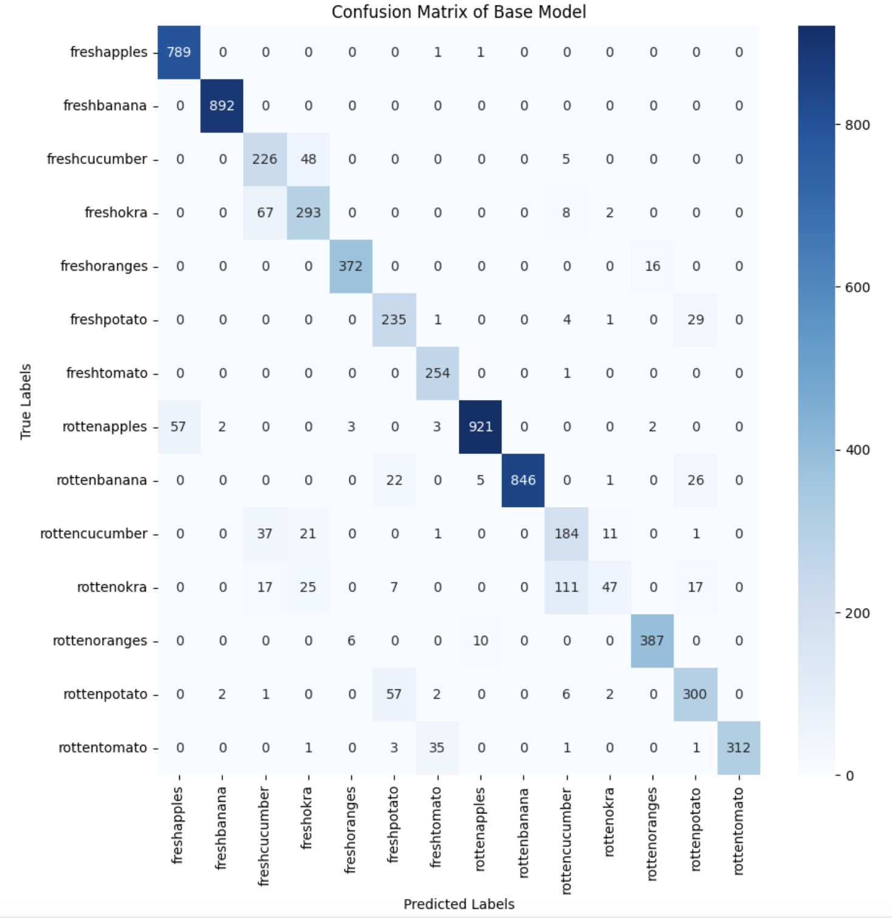
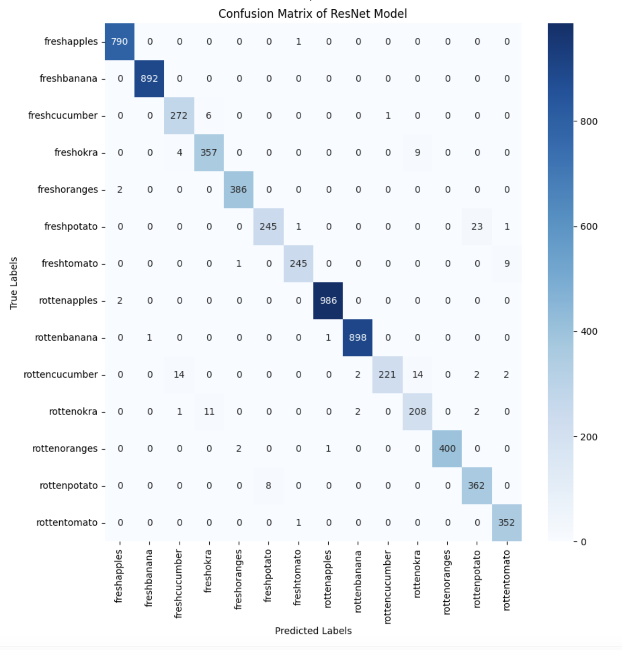
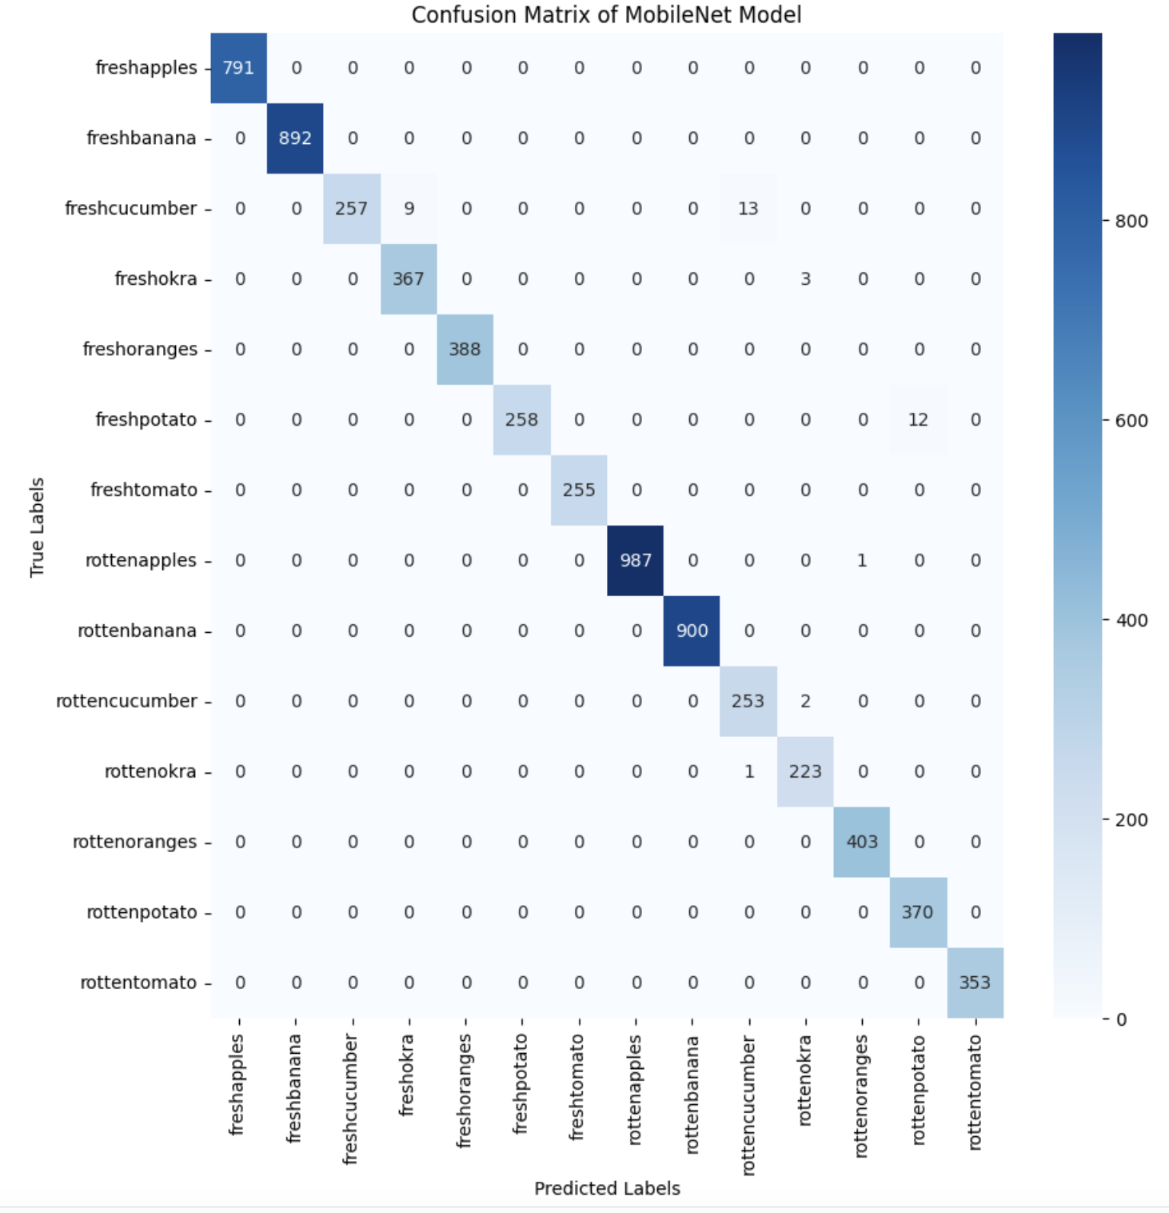
RESULTS
89.91%
98.16%
99.39%
Custom model validation accuracy
ResNet model validation accuracy
MobileNet model validation accuracy

Slide 6

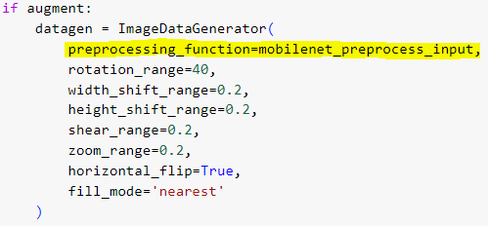
TECHNICAL CHALLENGES
Image Preprocessing
Did not originally incorporate image preprocessing techniques.
Imported processes from keras applications package to fix the issue.
Image Augmentation
Did not originally perform image augmentation, only achieved a maximum 90% validation accuracy.
Incorporation image augmentation pipeline to fix issue.
Image preprocessing and augmentation for MobileNet

Slide 7
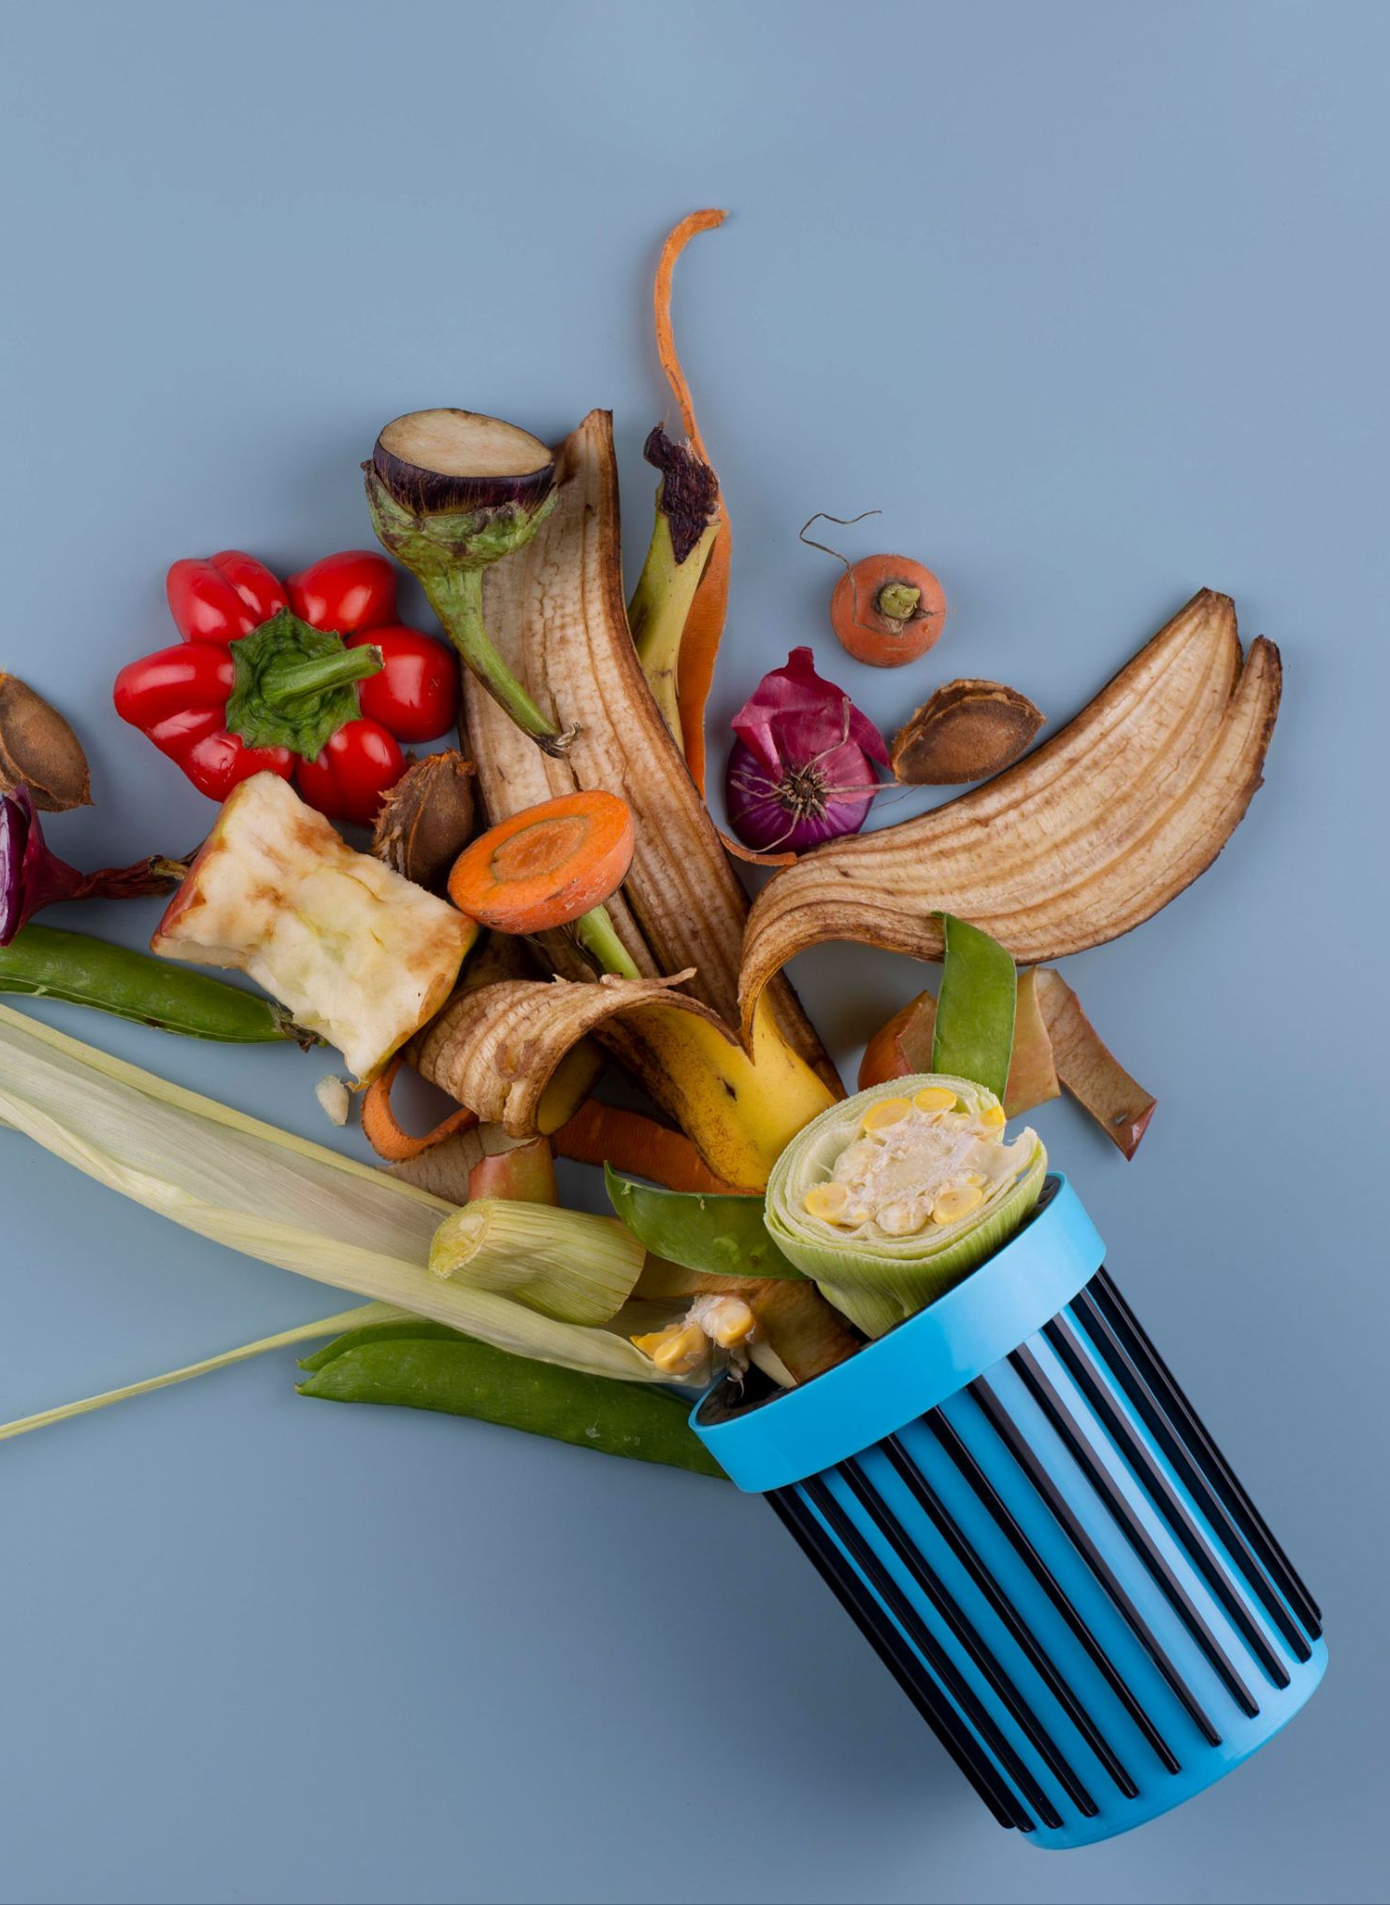
Takeaways
Stop wasting food
Experiments showed robust results – It is possible to classify food as fresh or rotten using CNNs
Future Adaptations

